Slide 1
TASK -3

Slide 2
Summary
The website http://testasp.vulnweb.com is vulnerable to injection .
And XXS vulnerability was detected in this website

Slide 3
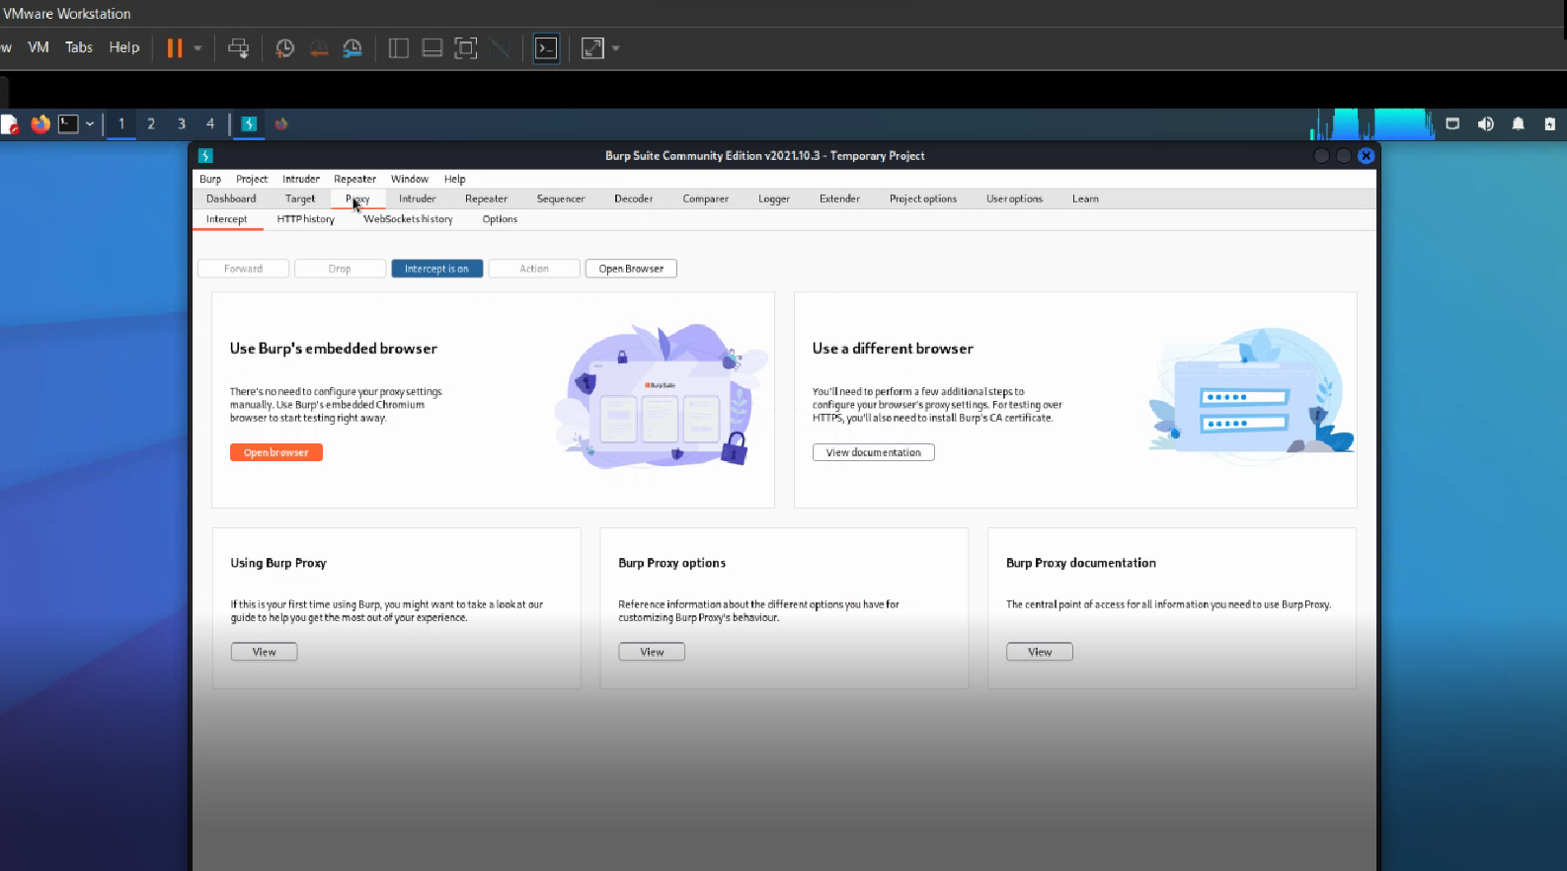
Steps to reproduce this attack
STEP 1 - open burpsuite and make sure intercept is on

Slide 4
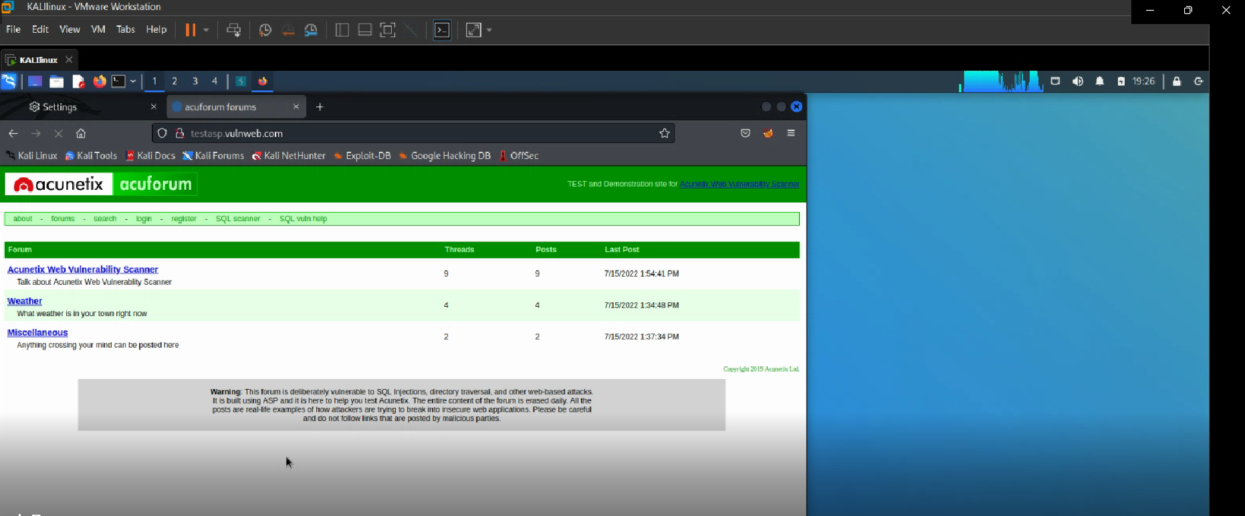
STEP 2 – open vulnweb and click on the link http://testasp.vulnweb.com

Slide 5
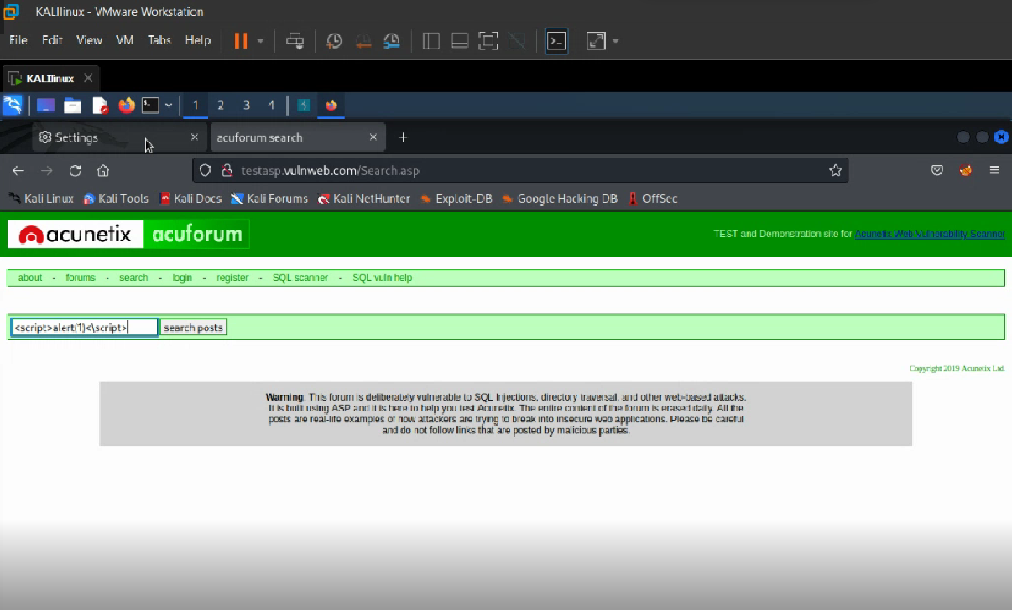
STEP 3 – go to search menu and search for <script>alert(1)</script>

Slide 6
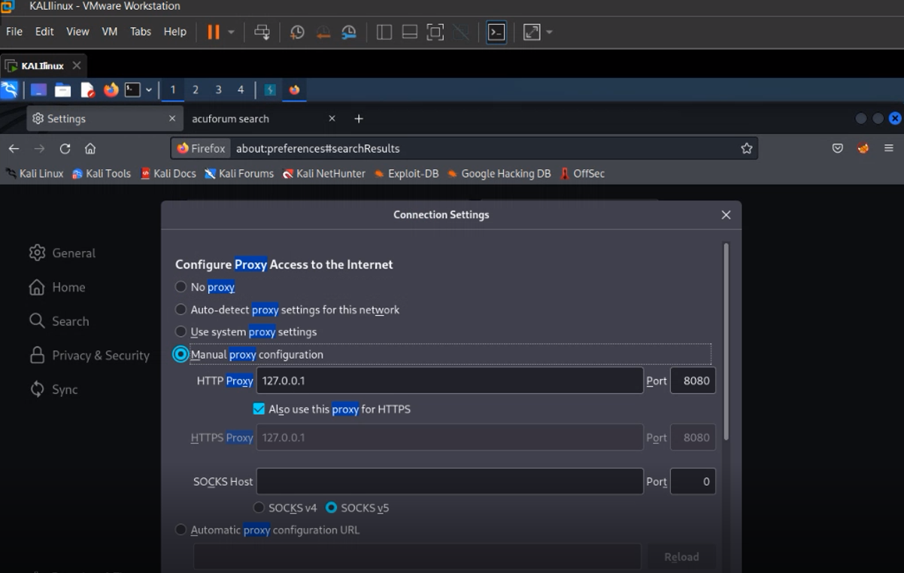
STEP 4 –make sure proxy settings are set to that of burpsuite

Slide 7
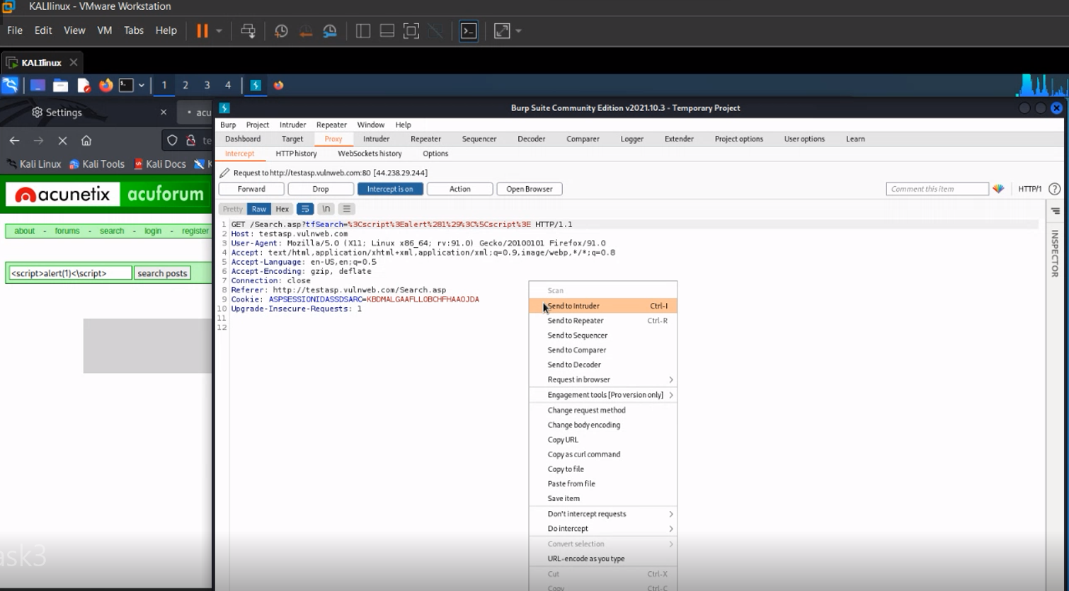
STEP 5 – click on search and while burbsuite opens turn intruder on

Slide 8
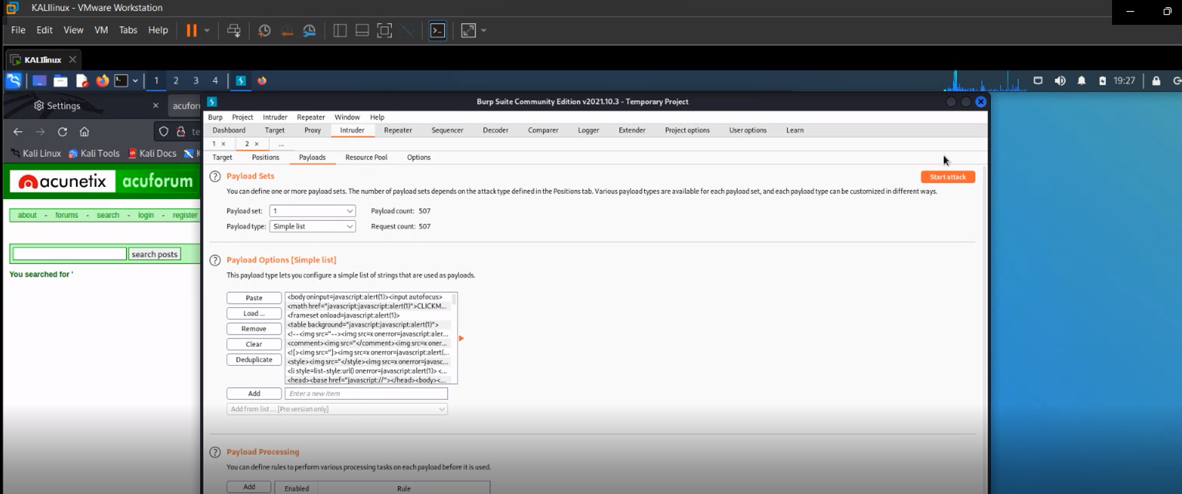
STEP 6 – go to payloads and select the list of xxs payloads list and click on start attack

Slide 9
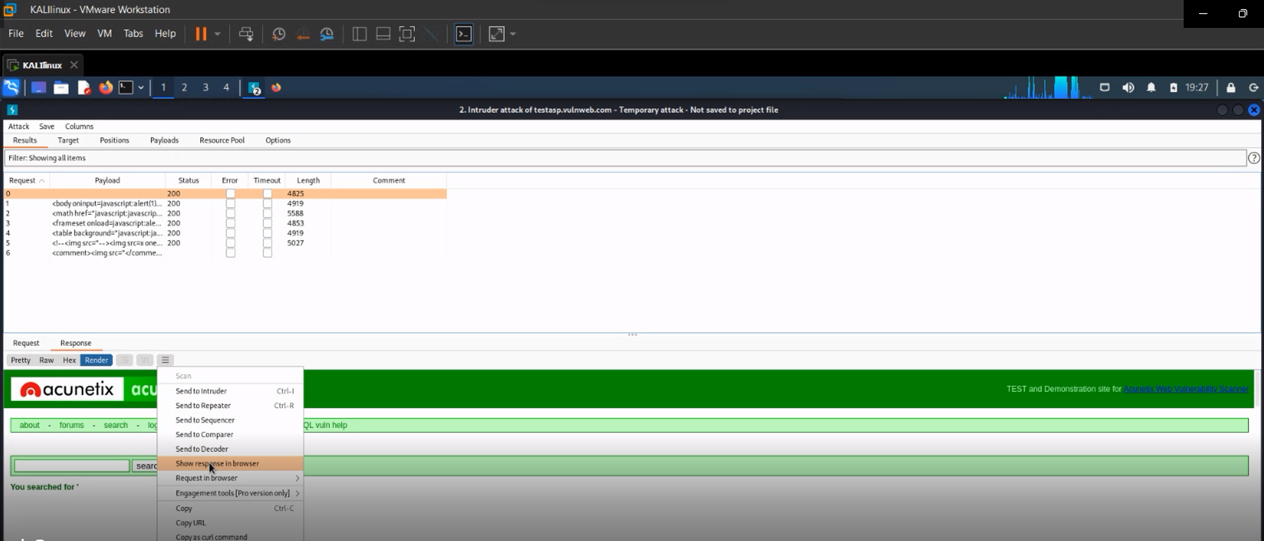
STEP 7 – go to response tab and click on render . Click on the 3 dots available and click on show in browser

Slide 10
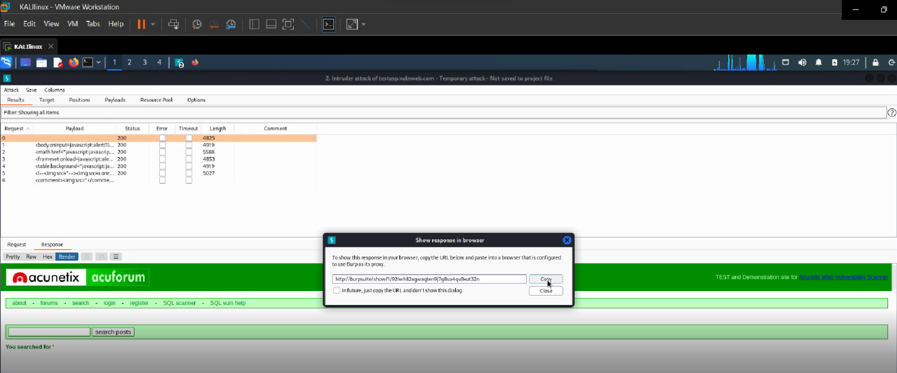
STEP 8 – copy the url and paste on the firefox browser

Slide 11
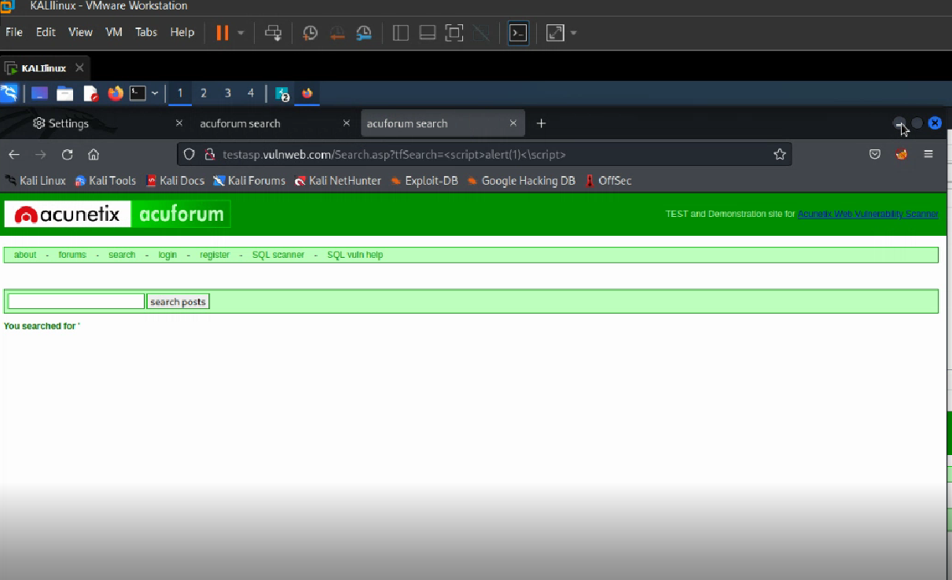
STEP 9 – you should see the result like displayed

Slide 12
VIDEO demonstration
Sent separately

Slide 13
Impacts
The data can be changed in the website using cross scripting
The data can be modified

